Slide 1
Networking devices
Inside a network (Use of MAC addresses, Layer: Data Link Layer, Layer-2 Device)
Hub: Older device
Switch: Modern device
To connect different networks (Use of IP addresses, Layer: Network Layer, Layer-3 Device)
Router

Slide 2
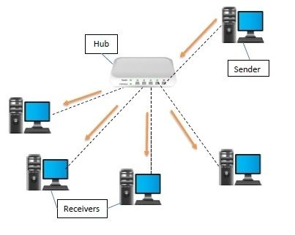
Hub
Earlier, hubs were used as connection devices in Ethernet
Hub is a dumb device, works only at the physical layer (Layer 1)
So, it does not know about MAC addresses, and hence floods out all the ports
All devices that use the same physical media and listen to each frame are considered to be in the same collision domain

Slide 3
Switch
Hubs are obsolete
Switch: An intelligent device – can filter traffic
Example
If a hub connects two branches of a network, it will flood both the branches for every received frame
A switch will check whether it should send it to the other branch of the network by comparing addresses, as discussed shortly

Slide 4
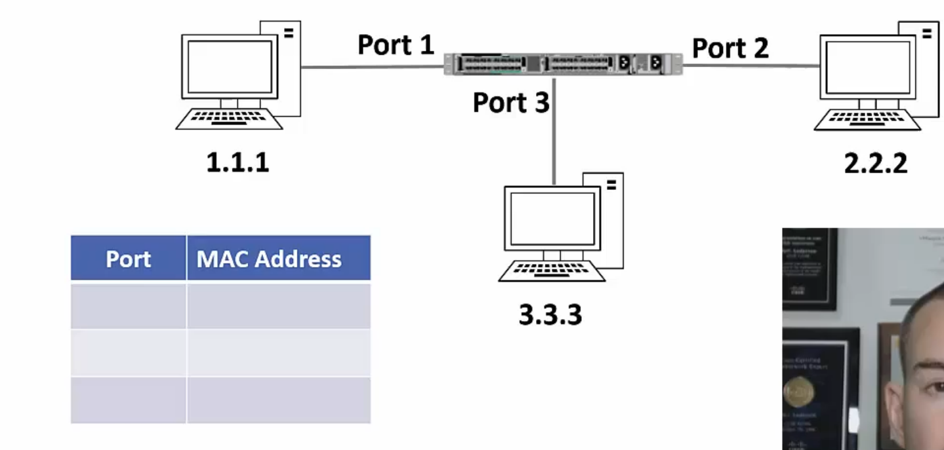
Switching Example – 1
Each switch maintains a mapping table

Slide 5
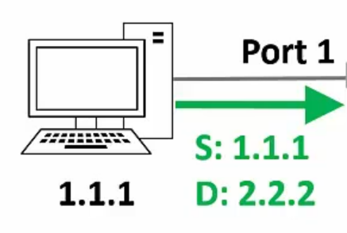
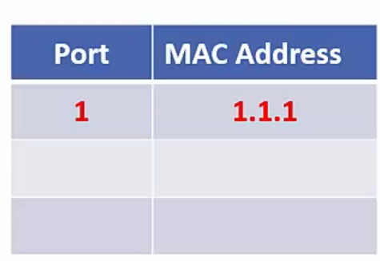
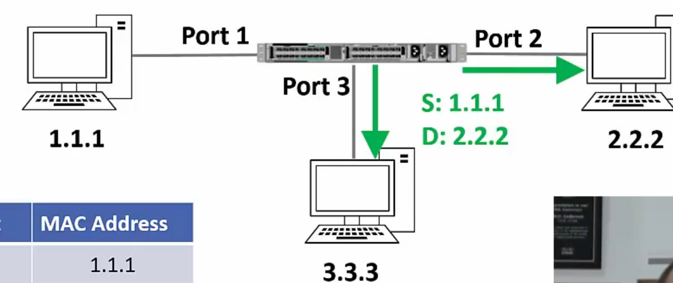
Switching Example – 2
Host 1.1.1 sends a frame to host 2.2.2
Switch sees the frame and updates its mapping table
The switch does not know where 2.2.2 is, so it floods out the frame
`

Slide 6
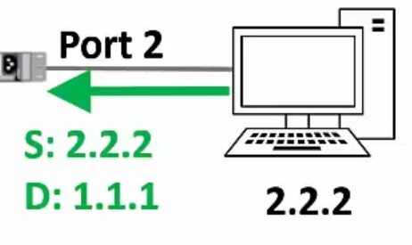
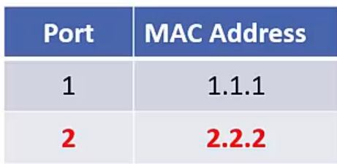
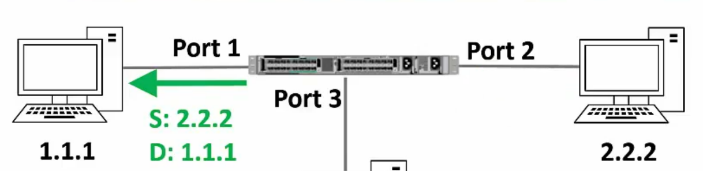
Switching Example – 3
Suppose host 2.2.2 sends a reply to 1.1.1
Switch sees the frame and updates its mapping table
The switch will send the frame only to 1.1.1

Slide 7
Router
A router works at layer 3 (network layer) and uses IP addresses to decide where to deliver packets
Remember: A switch works at layer 2 (data link layer) and uses MAC addresses to decide where to deliver packets
Device | Layer | Uses
Router | 3 (Network) | IP addresses
Switch | 2 (Data link) | MAC addresses

Slide 8
Routing
Routing means taking a packet from one device and sending it through the network to another device on a different network
Switching means taking a packet from one device and sending it through the network to another device on the same network
A switch can be used for sending traffic inside a network
For sending traffic outside a network we need a router

Slide 9
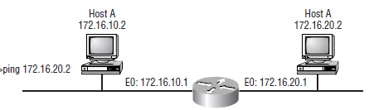
Routing Example
B
Host A and B are on different networks
On a command prompt, the user types ping 172.16.20.2
A packet is generated on the Host A machine using the Internet Protocol (IP)
Host A sends this packet to the router
The router opens the packet and understands that the destination host B is not on the same network
Router forwards the packet to host B
Note: Several additional steps are needed for this, which are not described here for simplicity

Slide 10
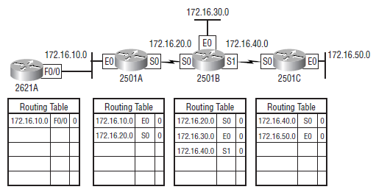
Routing Table
To perform routing, a router needs to build a routing table – Initial state

Slide 11
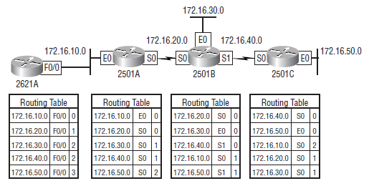
Routing Table after it is Updated
Called as converged routing table

Slide 12


Understanding Routing
Consider a passenger traveling from Pune to Sioux Falls, USA
Pune
Mumbai
San Francisco
Chicago
Sioux Falls
Hop Number | From | To | Passenger’s View
1 | Pune | Mumbai | Pune-Sioux Falls
2 | Mumbai | San Francisco | Pune-Sioux Falls
3 | San Francisco | Chicago | Pune-Sioux Falls
4 | Chicago | Sioux Falls | Pune-Sioux Falls

Slide 13

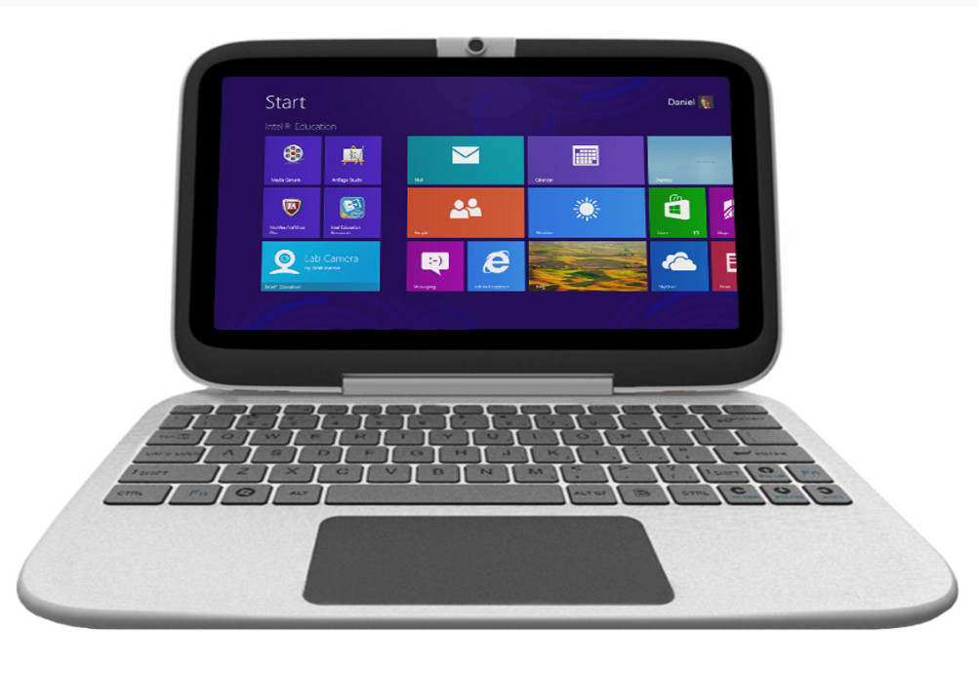

Understanding Routing
Consider a datagram/packet going from computer A to computer B
A
R1
R2
R3
B
 | Data Link Layer | View
Hop Number | From | To | IP View
1 | A | R1 | A-B
2 | R1 | R2 | A-B
3 | R2 | R3 | A-B
4 | R3 | B | A-B

Slide 14
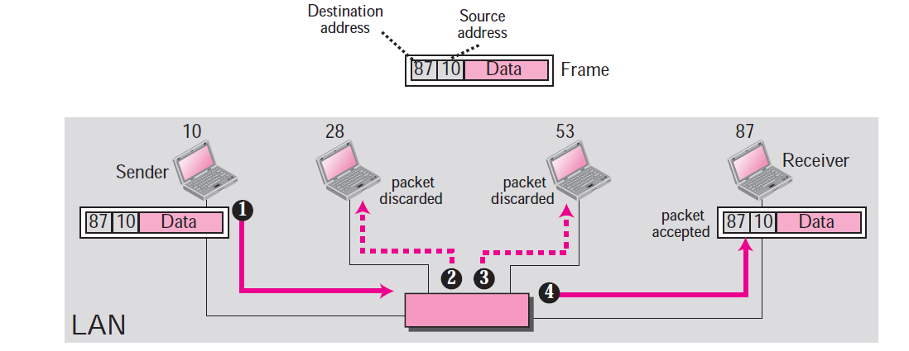
MAC Addresses and LAN

Slide 15
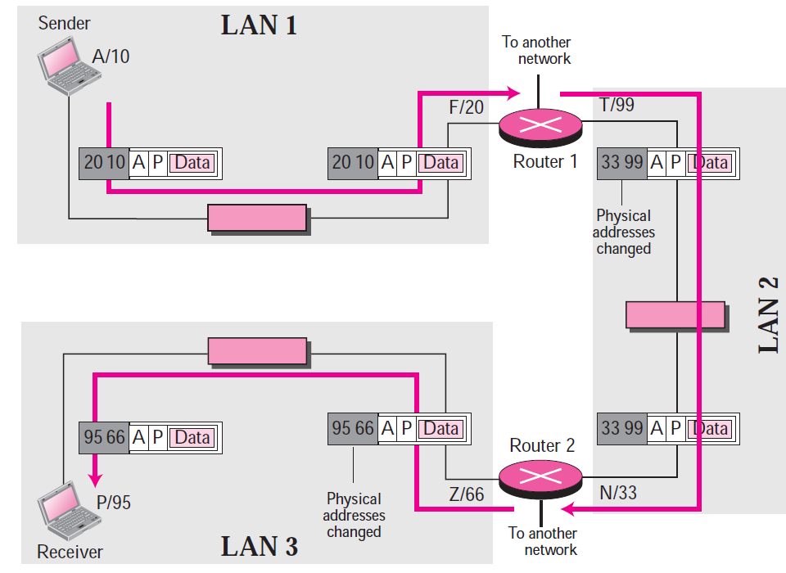
IP Addresses and the Internet

Slide 16
Hubs versus Switches versus Routers
Hub | Switch | Router
Operates at layer 1 (Physical layer) | Operates at layer 2 (Data link layer) | Operates at layer 3 (Network layer)
Works inside a LAN | Works inside a LAN | Works across networks
Generally works only for Ethernet | Generally works only for Ethernet | Supports Ethernet, ISDN, ADSL, etc
Has many ports | Has more ports | Has less ports
A dumb device – floods out all the ports; so does not know about MAC or IP addresses | Works with MAC addresses | Woks with IP addresses

Slide 17
Modern x86 Assembly Language (32-bit)
Go to https://dragonzap.com/downloads
Click on Nasm 2.14 under Installing x86 Assembler Dependencies
Add its installation path (e.g. C:\Users\akaha\AppData\Local\bin\NASM) to the PATH variable by using environment variables option
Then download the Mingw C compiler from the same link and install it also
Extract it under c: to create a directory such as C:\mingw-w64
Copy the path C:\mingw-w64\i686-8.1.0-posix-dwarf-rt_v6-rev0\mingw32\bin and add it to the PATH variable
On the command prompt, try nasm and then try gcc -v

Slide 18
32-bit Hello World (C:\code\assembly\1_hello_world.asm)
global _main
extern _printf
section .text
_main:
push message
call _printf
add esp, 4
ret
message:
db 'Hello World!', 10, 0

Slide 19
Code Explanation
global _main
extern _printf
section .text
_main:
push message
call _printf
add esp, 4
ret
message:
db 'Hello World!', 10, 0
global _main: We make the _main declaration and its code accessible from other programs when we assemble and link it by using the keyword global
extern _printf: We have _printf somewhere in the code, resolve it at the link time
section .text: The code segment
When the _main part runs: (1) Push the address of message on to the stack, (2) Call _printf to print the message, (3) Add 4 to the stack pointer, so take our message off the stack (like pop) … Note that on 32-bit machines, word = 4 bytes

Slide 20
Assemble, Link, Run
Open a command prompt in the code directory and assemble the code: nasm -fwin32 1_hello_world.asm
If there are no syntax errors, it should create a file 1_hello_world.obj
Now link the code: gcc 1_hello_world.obj
We should see a file named a.exe
Run: a.exe

